Slide 1
Best Practices for Installing KeyTruss

Slide 2
Table of Contents
Unloading, Inspecting & Storing Trusses… | 5
Pre-Installation Tasks………………………… | 12
Truss Installation Basics……………………… | 23
Lateral Restraint and Diagonal Bracing…… | 36
Temporary Restraint and Bracing………… | 42
Permanent Restraint and Bracing………… | 55
Installing Hip Sets……………………………… | 78
Installing Piggyback Trusses………………… | 84
Installing Valley Sets………………………….. | 89
Installing Parallel Chord Trusses…………… | 94

Slide 3
Table of Contents
Installing Long Span Trusses……………….. | 97
Installing Other Specialty Trusses…………. | 103
Construction Loading………………………… | 106
Damaged Trusses……………………………… | 111
Fall Protection………………………………….. | 117

Slide 4
Parts of a Truss
Top Chord
Webs
Bottom Chord
Heels

Slide 5
Unloading, Inspecting, and Storing Trusses

Slide 6
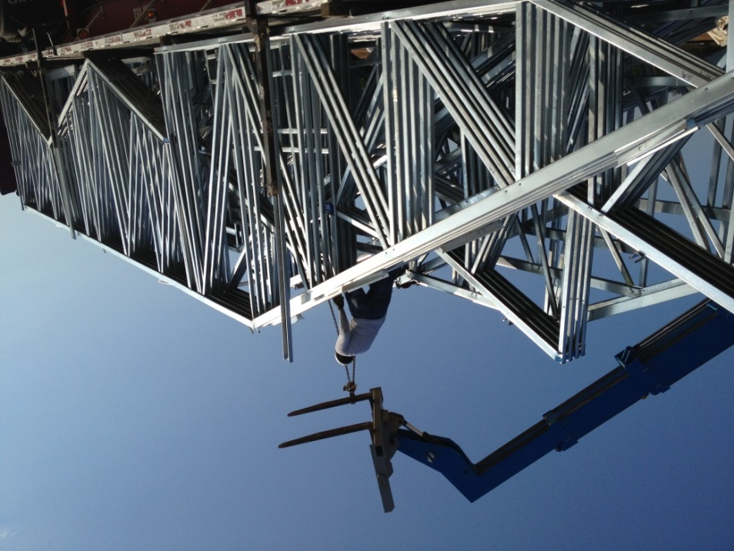
Unloading Truss Bundles
Unload as close as possible to job site
Lift bundles along the chords
Do not lift bundles that exceed crane/lift capacity
Take extra care with bundles of shallow or vaulted trusses which can bend excessively if not properly supported
Avoid lateral bending!

Slide 7
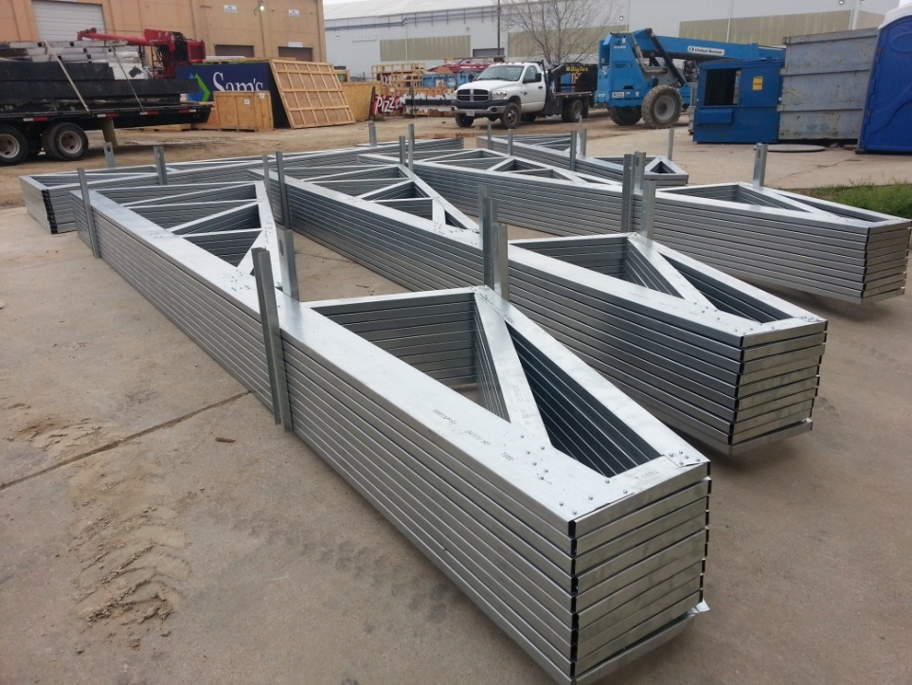
Storing Trusses
Proper storage of framing materials on the job site is the responsibility of the receiving entity, and requires that framing materials not be in direct contact with the ground and be protected from the elements. Adequate drainage and ventilation shall be provided to minimize the formation of “wet storage stain” or “white rust.”
− AISI Code of Standard Practice for CFS Structural Framing

Slide 8
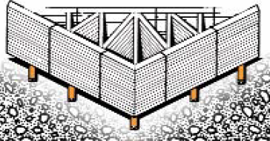
Storing Trusses
Store trusses on even ground or on slight slope to allow for draining
If storing horizontally, place blocking beneath at 8-10’ intervals
If storing vertically, brace trusses to avoid tipping or toppling
Cover trusses stored for more than 1 week

Slide 9
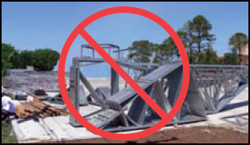
Unloading and Storing “Don’ts”
DO NOT lift truss bundles by banding
DO NOT drag or push trusses
DO NOT stand on truss bundles
DO NOT store unbraced bundles upright
DO NOT remove banding until installation begins

Slide 10
Inspecting Trusses
“It is the receiving party’s responsibility to verify that framing materials arrive in good condition. If framing materials arrive at a destination in damaged condition, the receiving party shall promptly notify the CFS component manufacturer prior to unloading the framing material, or promptly upon discovery and prior to installation…. If the contractor or the installer installs damaged material, then that party assumes the cost of repairing or installing new materials.”
− AISI Code of Standard Practice for CFS Structural Framing

Slide 11
Inspecting Trusses
Confirm delivered items correspond with BOL
Inspect trusses for damage
Report damage to ISF immediately
DO NOT cut, drill, relocate, add, or remove any truss member, screw, plate, or other connections until you have received instructions from ISF

Slide 12
Pre-Installation Tasks

Slide 13
Pre-Installation Tasks
Review truss documentation
Determine order of truss installation
Determine ground bracing method
Determine spacing of restraint and bracing
Conduct pre-installation meeting
Ensure building readiness
Stage trusses

Slide 14
Review Truss Documentation
Review documents provided by ISF:
Bill of Lading
Truss Design Drawings
Truss Placement Diagrams
CFSBCSI Summary Sheets
Promptly report any documentation issues to ISF

Slide 15
Determine Truss Installation Order
Decide which end or location within the building with which to start. This point is critical as subsequent trusses will be attached to the first truss via lateral and diagonal bracing.
If the roof is a hip style, the #1 hip girder is the starting point
If there is a hip at one end of the building and a gable at the other, start truss installation at the hip-set end
If the roof is a straight A-frame, the gable end truss is usually selected as the starting point

Slide 16
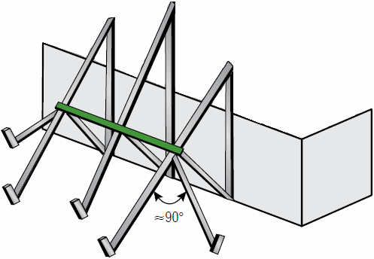
Determine Ground Bracing
Interior vs. exterior ground bracing dictated by site conditions:
Building height
Ground-level conditions
Use exterior ground bracing whenever possible
Additional, interior ground bracing placed in the opposite direction is also recommended

Slide 17
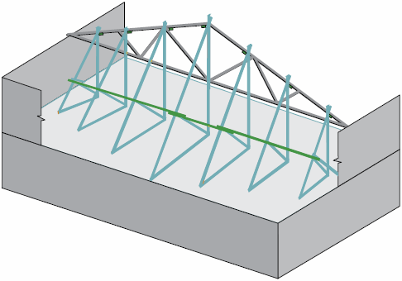
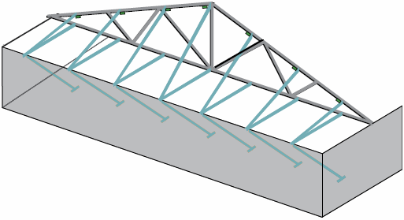
Determine Ground Bracing
Use interior ground bracing if ground level is too far from truss for exterior bracing
Two types of interior ground bracing:
Top of wall and back to floor below
Standard
Standard
Top of Wall

Slide 18
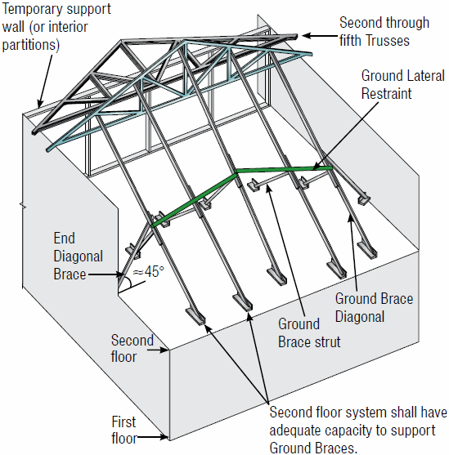
Determine Ground Bracing
Ground brace locations are determined by TCILR requirements
Ground bracing must be restrained and braced to prevent buckling

Slide 19
Conduct Pre-Installation Meeting
Prior to installation, the contractor should hold a safety and planning meeting with the installation crew and crane operator in order to:
Review construction documents
Review site-specific conditions
Review temporary and permanent restraint/bracing requirements
Ensure that crew members understand installation roles and responsibilities

Slide 20
Ensure Building Readiness
Are the structure’s “as built” dimensions the same as those in construction documents?
Are all load bearing supports plumb, level, and properly braced? Are they straight along their length and parallel where they should be?
Are the tops of all load bearing supports at the correct elevation?

Slide 21
Ensure Building Readiness
Are all required hangers, clips, tie-downs, and restraint/bracing materials onsite and located where they are needed?
Have construction trash and other obstacles been removed from the work area?
Fall safety restraints in place?

Slide 22
Stage Trusses
Unbundle and stage trusses in accord with defined installation plan
After banding has been removed from truss bundles, inspect individual trusses for:
Dislodged/missing screws or fasteners
Kinked, dislodged, or broken members
Damage or rust

Slide 23
Truss Installation Basics

Slide 24
General Installation Sequence
Install trusses in sets of four or five:
Hoist and set each truss into position straight, plane, and plumb
Connect the truss to its bearings
Install lateral restraint (top chord first)
Install diagonal bracing (top chord first)

Slide 25
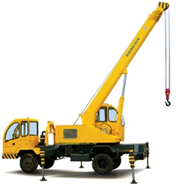
Hoisting & Placing Trusses
Small trusses can be lifted and placed by hand
Larger trusses must be lifted and placed by crane or forklift
Obtain the correct size crane or forklift; never exceed load capacity
Always use proper rigging and hoisting equipment

Slide 26
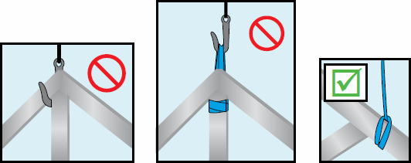
Hoisting & Placing Trusses
Connect lifting devices to the top chord of the truss using closed-loop attachments:
Use at least two lift points for trusses up to 45’
Use at least three lift points for trusses > 45’
DO NOT lift trusses by the peak or webs

Slide 27
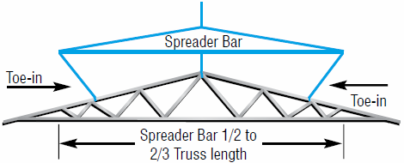
Hoisting & Placing Trusses
When using a spreader bar, be sure that lines “toe-in.” Lines that “toe out” can cause trusses to buckle

Slide 28
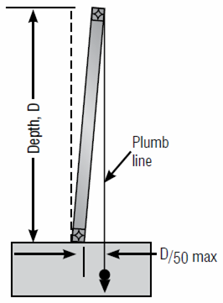
Installation Tolerances
Compliance with installation tolerances is critical to achieving an acceptable roof or floor line, and to accomplishing effective bracing. Leaning or bowing trusses can result in fasteners that miss the top chords when structural sheathing is applied and create excessive cumulative stresses on the bracing, which can lead to bracing failure and truss dominoing.
Out of Plumb
D/50 | D (ft)
¼” | 1’
½” | 2’
¾” | 3’
1” | 4’
1 ¼” | 5’
1 ½” | 6’
1 ¾” | 7’
2” | >= 8’

Slide 29
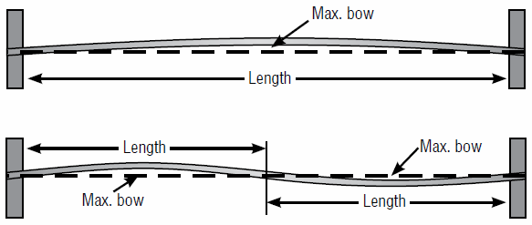
Installation Tolerances
The spacing along bearing supports must be within +/- ¼” of plan dimensions. Field conditions that force spacing beyond this tolerance must be reviewed and approved by the truss designer.
Out of Plane
Max Bow | Truss Length
¾” | 12-6-0
7/8” | 14-7-3
1” | 16-8-6
1 1/8” | 18-9-10
1 ¼” | 20-9-10
1 3/8” | 22-10-13
1 ½” | 25-0-0
1/3/4” | 29-2-6
2” | >= 33-3-10

Slide 30
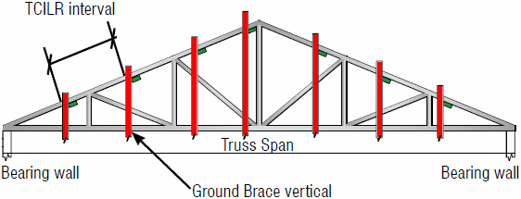
Installing the First Truss Set
The initial installation will consist of a set of five trusses. Install the first truss, completing the following steps in the order presented:
Hoist and set the first truss into position straight, plane, and plumb
Connect the truss to each bearing
Connect the truss to ground brace verticals where they intersect the top and bottom chords of the truss

Slide 31
Installing the First Truss Set
Install the second truss, completing the following steps in the order presented:
Hoist and set the truss into position straight, plane, and plumb
Connect the truss to its bearings
Connect the first and second trusses together on their top chords using lateral restraint.
NOTE: If the lateral restraint is to become part of the permanent restraint and bracing structure, attach it to the underside of the top chords; otherwise, it can be attached to the top of the top chords.

Slide 32
Installing the First Truss Set
Install trusses 3-5, hoisting, placing, and securing each truss to its bearings
Attach each truss to the preceding truss with lateral restraint on the top chords immediately after securing it to its bearings
After all five trusses have been placed and secured to bearings and top chord lateral restraint, install lateral restraint on webs and bottom chords
NOTE: Rows of bottom chord lateral restraint installed for the purpose of stabilizing the bottom chords of the trusses during installation should be spaced no more than 15' on-center

Slide 33
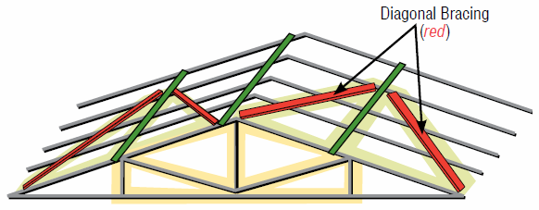
Installing the First Truss Set
Install top chord diagonal bracing immediately after the first 5 trusses have been set and restrained. Thereafter, install top chord diagonal bracing at no more than 20’ intervals.
With the top chord plane fully braced, install diagonal bracing on the web plane, and then the bottom chord plane

Slide 34
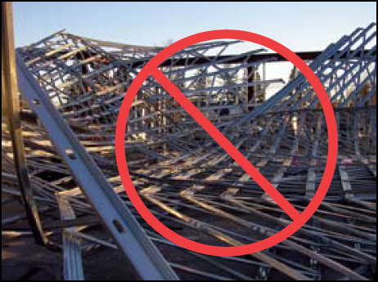
Removing Ground Bracing
WARNING! Do not remove ground bracing until all top chord, web, and bottom chord lateral restraint and diagonal bracing is installed for at least the first five trusses

Slide 35
Installing Remaining Trusses
Install the next five trusses with top chord temporary lateral restraint, followed the installation of restraint on webs and the bottom chord
Install diagonal bracing starting with the top chord, and followed by webs and the bottom chord
Repeat this process with sets of five trusses until all of the remaining trusses have been installed

Slide 36
Lateral Restraint
and
Diagonal Bracing

Slide 37
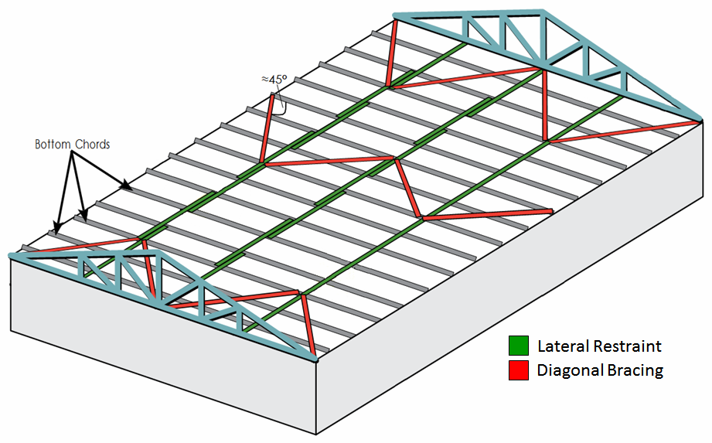
Restraint & Bracing
Lateral Restraint − A structural member installed at right angles to a chord or web member of a truss to reduce the laterally unsupported length of the truss member
Diagonal Bracing − A structural member installed at an angle to a truss chord or web member and intended to stabilize truss members and/or truss lateral restraint

Slide 38
Restraint & Bracing
Come in two varieties:
Temporary − Provides support during installation. Holds trusses in their proper location, plumb and in plane, until permanent individual truss member restraint, diagonal bracing, and permanent building stability bracing are fully installed.
Permanent − Restraint and bracing that provide on-going structural support and resistance to gravity, wind, and other loads during the lifetime of the building (a.k.a. Permanent Building Stability Bracing)

Slide 39
Restraint & Bracing
NOTE! When properly planned and executed, temporary lateral restraint and diagonal bracing can serve as permanent lateral restraint and diagonal bracing

Slide 40
Restraint & Bracing
Common materials used:
CFS hat channel and stud sections
Wood structural panels
Gypsum board sheathing
Metal decking
Metal purlins and straps
Proprietary metal restraint/bracing

Slide 41
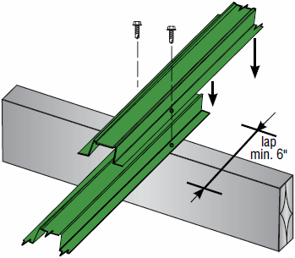
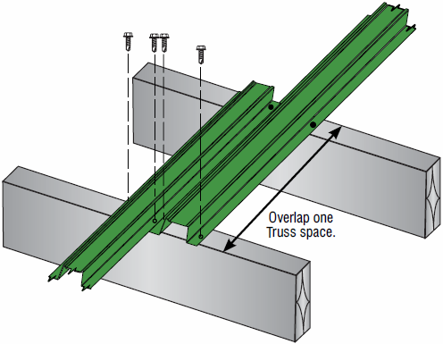
Restraint & Bracing
Minimum size of steel used as temporary and permanent lateral restraint and diagonal bracing:
33 mil 1 ½” hat channel
33 mil 2 ½” stud section
Lateral restraints and diagonal bracing can be installed on either the top or bottom edge of chords and can be “nested” or “overlapped”

Slide 42
Temporary
Restraint and Bracing

Slide 43
Temporary Restraint & Bracing
Temporary restraint and bracing must be applied to all of the following planes:
Top chord plane (roof plane)
Web member plane (sloping or vertical plane perpendicular to trusses)
Bottom chord plane (ceiling plane)
Top chord restraint and bracing are the most important and must be installed first

Slide 44
Temporary Restraint & Bracing
Short Member Temporary Lateral Restraint − Short, structural members fastened at right angles to truss chords for the purpose of reducing the laterally unsupported length of the truss member
Continuous Lateral Restraint − An uninterrupted line of structural members installed at right angles to a chord or web member to reduce the laterally unsupported length of the truss member. The CLR must be properly braced to prevent the simultaneous lateral deformation and/or buckling of the series of truss members to which it is attached. ALWAYS diagonally brace continuous lateral restraint!

Slide 45
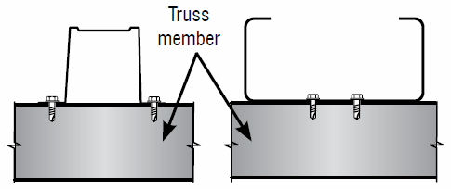
Temporary Lateral Restraint
Use a minimum of 2 #10 self-drilling tapping screws at each truss to lateral restraint joint connection
Screws must draw metal together tightly, with screw heads flush. Screws are to extend a minimum of three exposed threads through the last piece of steel in the connection.

Slide 46
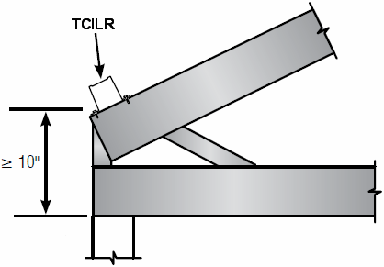
Temporary Lateral Restraint
TOP CHORD
The most important of all lateral restraints, TCTLR must be installed as soon as a truss is secured to its bearings
Required at every pitch break
Must be continuous if heel >= 10”

Slide 47
Temporary Lateral Restraint
TOP CHORD
Can be attached to either the top or the bottom of the top chord
Spacing determined by:
Overall truss length
Length of top chord between pitch breaks (change of slope)
MAXIMUM TCILR SPACING
Truss Span | Spacing
Up to 30’ | 10’ On Center
30’ – 45’ | 8’ On Center
46’ – 60’ | 6’ On Center
61’ – 80’ | 4’ On Center

Slide 48
Temporary Lateral Restraint
WEB
Requirements and spacing defined on the Truss Design Document (TDD)
Mono, deep flat, and other truss types with deep ends require TCILR on long web members at the deep end of the truss
BOTTOM CHORD
Used to stabilize bottom chords and maintain proper spacing between trusses
Most often placed on the top edge of bottom chords

Slide 49
Temporary Lateral Restraint
BOTTOM CHORD (continued)
Installed in rows no more than 15’ on center
Long spans, heavy loads, or truss spacing > 2’ o.c. often require close spacing of restraint
Must connect ends of each row of bottom chord temporary lateral restraint to end walls
May be removed after the permanent ceiling diaphragm is in place, or may become part of the permanent building stability bracing

Slide 50
Temporary Diagonal Bracing
TOP CHORD
Install at no more than 20’ intervals
WEB
Critical in preventing trusses from leaning or dominoing
Mandatory for webs that require CLR
Web members that require more than one row of CLR must have CLRs and diagonal bracing installed as the trusses are installed
Mono, deep flat, and other truss types with deep ends require temporary diagonal bracing on long web members at the deep end of the truss

Slide 51
Temporary Diagonal Bracing
WEB (continued)
Install web temporary diagonal bracing:
On vertical webs whenever possible
At or near each row of bottom chord temporary lateral restraint
At the same spacing as bottom chord temporary lateral restraint
So that braces cross web members at approximately 45 degrees
With a minimum of two #10 SDS at each end and to each intersecting web

Slide 52
Temporary Diagonal Bracing
BOTTOM CHORD
Used in conjunction with BCTLR to stabilize bottom chords and maintain proper spacing between trusses
Most often placed on the top edge of bottom chords
May be removed after the permanent ceiling diaphragm is in place, or may become part of the permanent building stability bracing

Slide 53
Temporary Diagonal Bracing
BOTTOM CHORD
Added at each end of BCTLR and at every 10 truss spaces (20’ max.)
Long spans, heavy loads, or truss spacing > 2’ o.c. often require close spacing of bracing

Slide 54
As You Go…
Sheath the top chord as trusses are installed (after securing the bracing onto the web and bottom chord planes)
Remove only as much temporary lateral restraint and diagonal bracing as necessary to attach structural sheathing
Install all permanent building stability bracing immediately
Once the installation crew becomes familiar with the procedure, permanent restraint and bracing for webs and bottom chords can be installed in the time it takes to release the hoist and install the next truss

Slide 55
Permanent
Restraint and Bracing

Slide 56
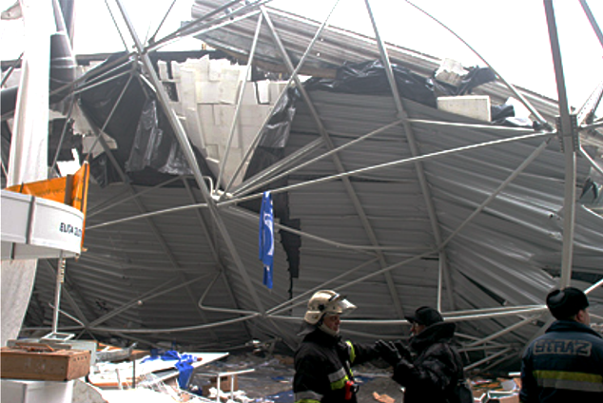
Permanent Restraint & Bracing
WARNING! Disregarding permanent individual truss member restraint and permanent building stability bracing recommendations is a major cause of truss field performance problems and has been known to lead to collapsed roof and/or floor systems. Failure to install the proper restraint and bracing will greatly increase the probability of truss performance problems or an accident resulting in property damage, personal injury, or death.

Slide 57
Permanent Restraint & Bracing
The building designer is responsible for:
The design and detailing of structural sheathing and diaphragms
The design and detailing of purlins and the PBSB for the roof system
Sheathing and attachment requirements (i.e. fastener size and spacing) are provided on construction documents and/or within the building code
Note! Not all sheathing products are structural

Slide 58
Permanent Restraint & Bracing
Trusses are not designed to resist lateral loads and rely on permanent building stability bracing (PBSB) to transfer lateral loads to the supporting structure
Permanent bracing provides sufficient support at right angles to the plane of the truss to hold every truss member in position
Certain individual truss members also require permanent lateral restraint and bracing to prevent buckling under the applied design loads

Slide 59
Permanent Restraint & Bracing
Material and fasteners used to restrain and brace trusses must be of sufficient strength and stiffness to hold every truss member in position
Common materials used to brace truss members include: wood structural panels, metal decking (panels), gypsum board sheathing, CFS sections, metal purlins, and proprietary metal restraint/bracing products
The minimum size of a steel section used as a lateral restraint and diagonal bracing is 33 mil 1-½" hat channel or 33 mil 2-½" stud section unless specified by the building designer

Slide 60
Permanent Restraint & Bracing
TOP CHORD
Metal purlins are most often used where trusses are spaced greater than 4' o.c.
Purlins must be properly sized and fastened to the top chords of trusses in accordance with the construction documents
Trusses must be designed so that the maximum allowable unbraced length of top chords is greater than or equal to the o.c. spacing of purlins

Slide 61
Permanent Restraint & Bracing
TOP CHORD
Without some permanent diagonal bracing, purlins by themselves only ensure that the top chords of a trusses will all buckle in the same direction
Bracing is typically provided by attaching structural sheathing directly to purlins, such as metal decking or wood structural panels
Metal decking and wood structural panels must be designed to support the building designer's defined loads at the o.c. spacing of the trusses

Slide 62
Permanent Restraint & Bracing
WEB
Permanent web-member restraint is typically accomplished by either:
Reducing the unsupported length of the web member (via lateral restraint), or
By reinforcing the member with additional material (increasing its cross-section)
The TDD indicates which web members (if any) require permanent restraint

Slide 63
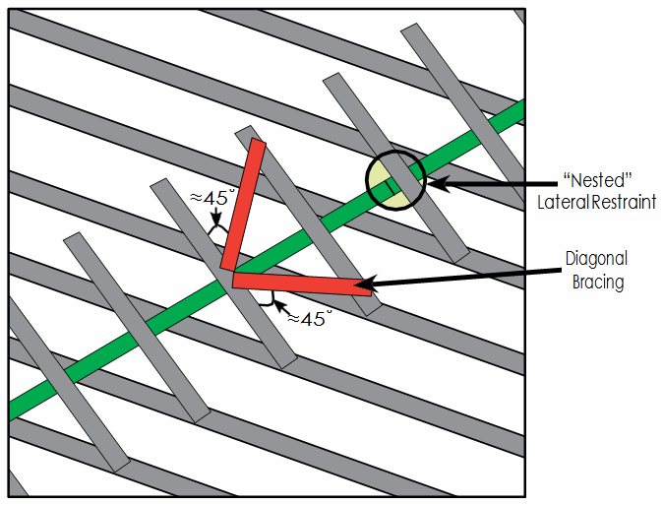
Permanent Restraint & Bracing
WEB
Attach lateral restraint at the locations shown on the TDD together w/ a diagonal brace at an angle of approximately 45˚ to the lateral restraint

Slide 64
Permanent Restraint & Bracing
WEB
If individual web member permanent lateral restraint is required, hat channel or stud section CLR, attached at right angles to the web, in combination with diagonal bracing, is most frequently specified
Webs may require one or more rows of CLR (TDD will specify the number of rows and approximate locations)
Diagonal bracing is required to restrain the CLRs and to transfer the cumulative force from the CLRs to a lateral force resisting system such as the roof or ceiling diaphragm

Slide 65
Permanent Restraint & Bracing
WEB
Repeat diagonal bracing every 20' or as specified
Position the diagonal brace so that it crosses the web in close proximity to the lateral restraint
Diagonal bracing should be attached as close to the top and bottom chord planes as possible, and to each web that it crosses. This provides rigidity that prevents the webs from displacing laterally.

Slide 66
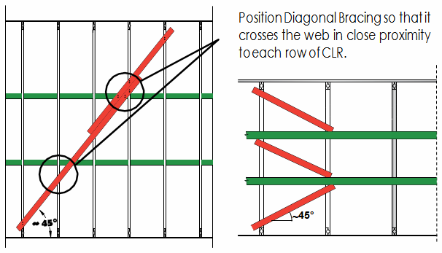
Permanent Restraint & Bracing
WEB
For webs requiring two rows of CLR, the concepts are the same as those used to brace a single row of CLR:
Position diagonal braces to cross webs in close proximity to each lateral restraint to minimize the out-of-plane bending forces in the web
Attach diagonal braces as close as possible to the top and bottom chord planes and to each web that the diagonal braces cross

Slide 67
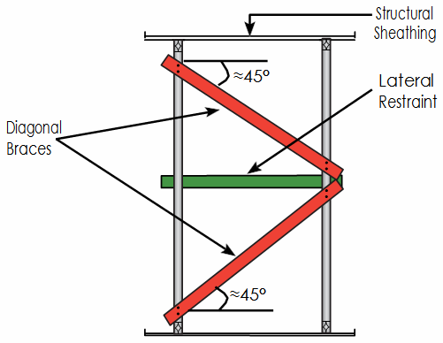
Permanent Restraint & Bracing
WEB
Diagonal bracing with CLRs work most efficiently when applied to three or more similar trusses
If there are only two adjacent trusses in which the webs align, diagonal bracing and lateral restraint can still be used. One option is to install two diagonal braces. Attach one end of each diagonal brace to the web at the perm- anent restraint location shown on the TDD, and attach the other end near the top or bottom of the web of the adjacent truss.

Slide 68
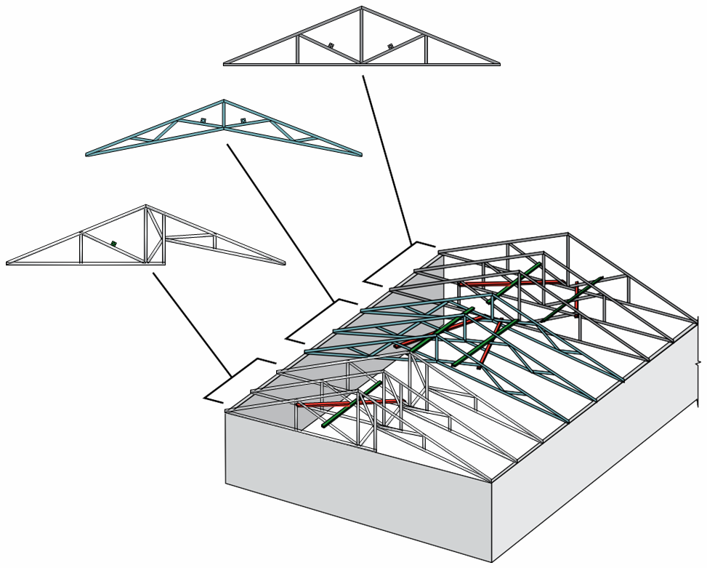
Permanent Restraint & Bracing
WEB
Diagonal bracing combined with lateral restraint can also be used with small groups of trusses. Extend the diagonal bracing from the top chord to the bottom chord of adjacent trusses. Attach diagonal bracing to the web of the middle truss near the location of the CLR, and to each intersecting truss. This provides rigidity that prevents webs and the CLR from displacing laterally.

Slide 69
Permanent Restraint & Bracing
WEB
To help transfer large bracing forces into the roof and ceiling diaphragms, blocking may need to be installed between the trusses on either side of the diagonal brace location. Blocking should fit snuggly between trusses and attach to the trusses and the diaphragm. This blocking helps to transfer the lateral load directly from the diagonal brace to the diaphragm.

Slide 70
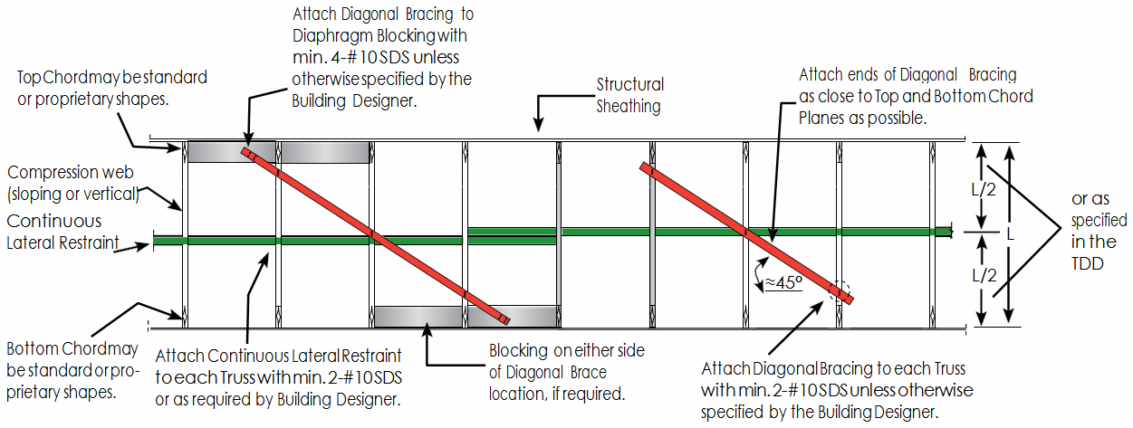
Permanent Restraint & Bracing

Slide 71
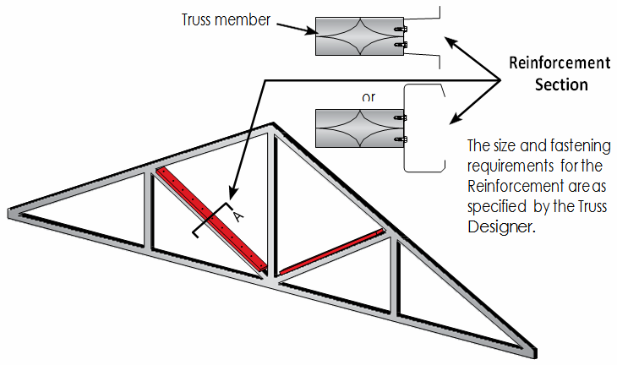
Permanent Restraint & Bracing
WEB
Hat channel, stud section, track, or other proprietary reinforcements are options that involve adding material to increase a web’s resistance to buckling. Reinforcement is typically used as an alternative to the combination of continuous lateral restraint (CLR) and diagonal bracing when CLR is not possible or desirable.

Slide 72
Permanent Restraint & Bracing
SWAY BRACING (WEB)
Designed and installed at the discretion of the building designer and not always required
Diagonal bracing installed at both ends of a building and repeated at specified intervals along its length to help stabilize the truss system and minimize lateral movement
If continuous, it also serves to distribute gravity loads between trusses of varying stiffness

Slide 73
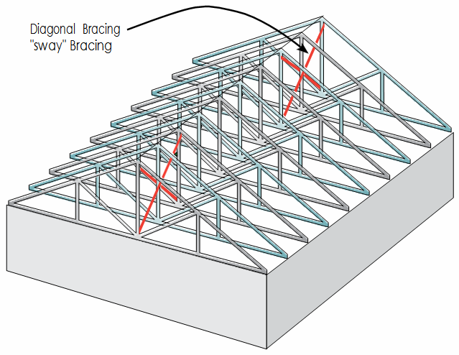
Permanent Restraint & Bracing
SWAY BRACING (WEB)
Typically installed on web members (verticals whenever possible) located at or near each row of bottom chord lateral restraint and should extend from the top chord plane to the bottom chord plane at right angles to the trusses

Slide 74
Permanent Restraint & Bracing
BOTTOM CHORD
Permanent support for bottom chords is typically provided by attaching gypsum board panels or CFS lateral restraint, properly braced against lateral movement
Bottom chord permanent lateral restraint must be installed at the spacing indicated on the TDD and/or by the building designer, whichever is less
NOTE: The hat channel specified in certain fire-rated assemblies of trusses is not structural and typically does not take the place of lateral restraint and diagonal bracing required to restrain and brace the bottom chord

Slide 75
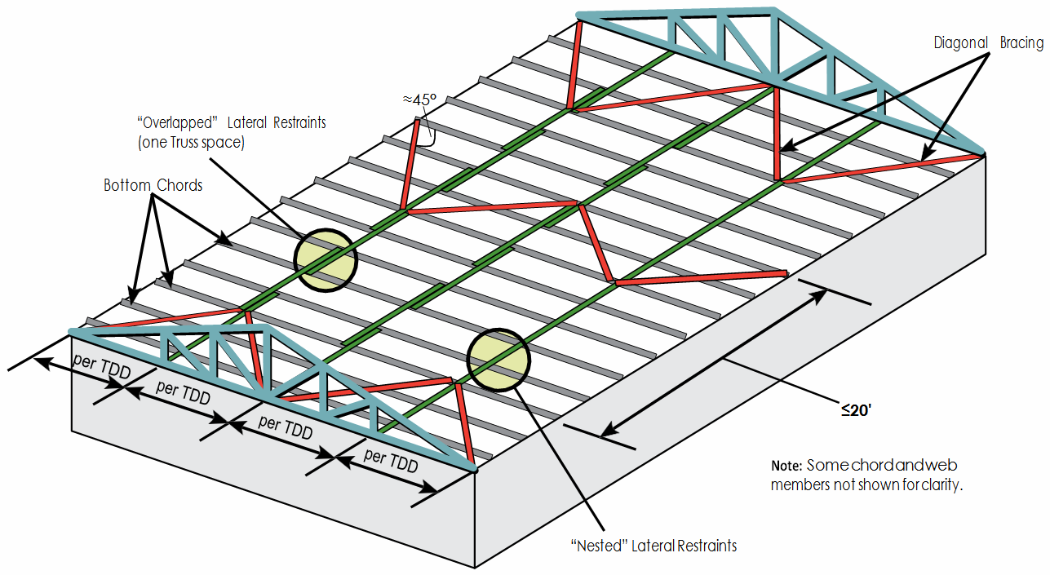
Permanent Restraint & Bracing
BOTTOM CHORD
Install rows of diagonal bracing at intervals of no more than 20' along the length of the building, or as specified by the building designer, to provide stability and transfer the forces from the lateral restraint to a lateral force resisting system

Slide 76
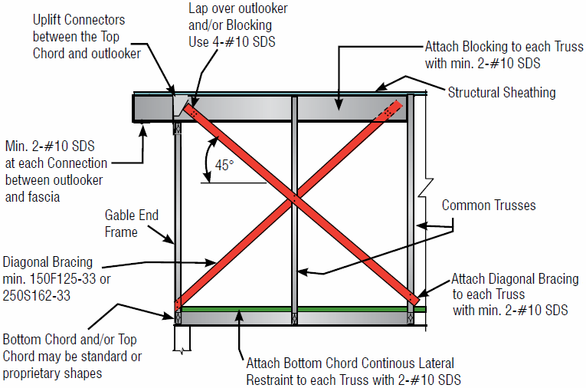
Permanent Restraint & Bracing
GABLE END FRAME
Typical gable end frame bracing and reinforcement details include blocking at the ceiling and roof level diaphragms, gable stud reinforcement, horizontal reinforce- ment, and/or diagonal bracing, mechanical connectors/straps, and specific fastener size and frequency schedules

Slide 77
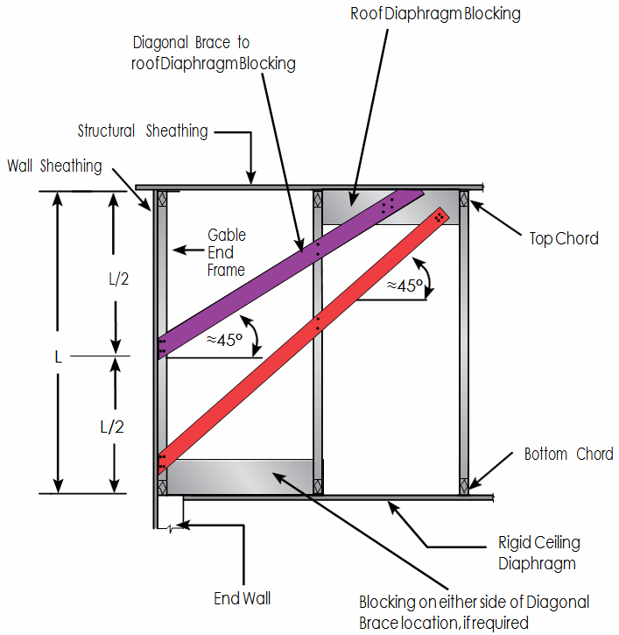
Permanent Restraint & Bracing
GABLE END FRAME
The diagonal brace from the top of the end wall to the top chord of the truss imparts a vertical force to the truss top chord. This is in addition to any uplift forces the roof sheathing imparts to the truss from wind. The load from this brace must be considered in the design and attachment of the supporting truss.

Slide 78
Installing Hip Sets

Slide 79
Hip Set Installation
Position the hip girder truss on the bearing walls at the specified end wall setback
If the hip girder truss consists of multiple plies, it is much easier to fasten the plies together and install the end jack hangers (if required) on the ground before lifting the girder truss into place
Permanently attach the girder truss to bearing supports
Note: All plies of a multi-ply girder truss are to be attached per the fastening schedule on the TDD before attaching any framing members or applying any loads

Slide 80
Hip Set Installation
While crane continues to hold girder truss in place, install all corner and end jacks with all permanent truss-to-bearing connections
Per the TDD, attach jack trusses at or near the top chord and at or near the bottom chord of the girder
Install the next hip truss with short member temporary lateral restraint
Attach each short member temporary lateral restraint to the top chord of the hip girder truss and adjacent hip truss. Short member temporary lateral restraint should be long enough to extend at least 1.5" past the top chord of each truss.

Slide 81
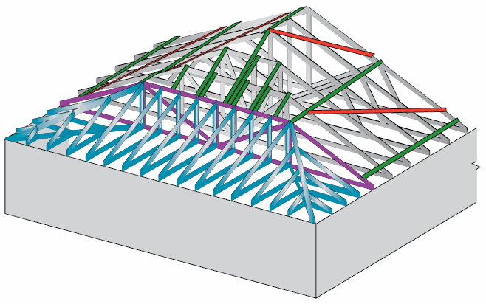
Hip Set Installation
Place short member temporary lateral restraint at pitch breaks and the sloped portions of the top chords

Slide 82
Hip Set Installation
Note: Permanently connecting the end jacks to the end wall and girder truss as early in the installation process as possible dramatically increases the stability of the hip girder truss and the safety of the structure

Slide 83
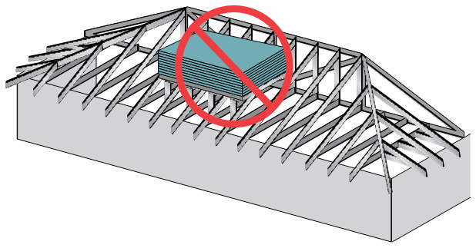
Hip Set Installation
DO NOT stack materials or stand on end jacks as it causes instability in the hip girder truss

Slide 84
Installing Piggyback Trusses

Slide 85
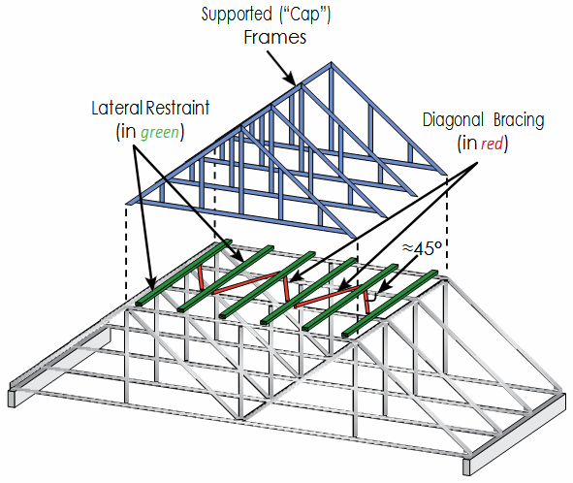
Installing Piggyback Trusses
With piggyback (a.k.a. stub and cap) trusses, the supporting trusses must be completely installed with all permanent building stability bracing BEFORE the cap trusses are installed
Diagonal bracing can be installed between the rows of lateral restraint on the top chord of the support-ing truss, or on the bottom of the top chord of the supporting truss

Slide 86
Installing Piggyback Trusses
RESTRAINT & BRACING
It is critical to make sure that the top chord of the stub truss is adequately braced to prevent it from buckling out from under the cap truss. Bracing for the top chord can be accomplished in several ways including:
Rows of continuous lateral restraint & diagonal bracing
Connecting CLR into the roof diaphragm
Adding structural sheathing
Some other equivalent means
Multiple rows of CLR are typically required across the length of the flat portion of the top chord of a stub

Slide 87
Installing Piggyback Trusses
RESTRAINT & BRACING
If structural sheathing is used to brace the flat portion of top chords, openings must be provided for ventila-tion between upper and lower portions of the piggyback assembly
TDD provides maximum assumed spacing for lateral restraints or sheathing to the top chord, along with the assumed thickness of the restraint and the minimum connection requirements between the cap and stub
Stub trusses must have all temporary bracing and top chord permanent bracing installed BEFORE caps are lifted into place

Slide 88
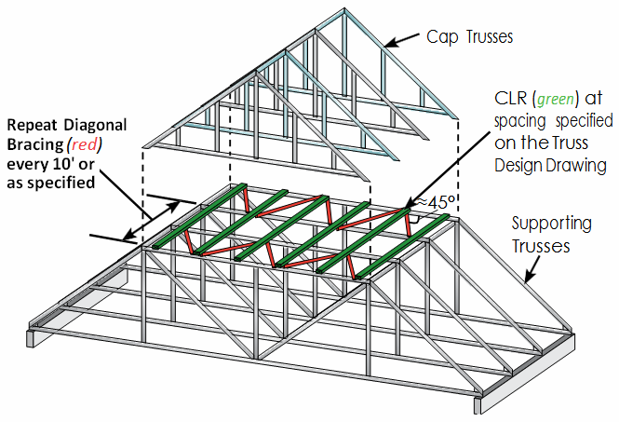
Installing Piggyback Trusses
RESTRAINT & BRACING
Diagonal bracing (red), can be installed between the rows of lateral restraint (green) on either the top or the bottom of the top chord of the stub truss

Slide 89
Installing Valley Sets

Slide 90
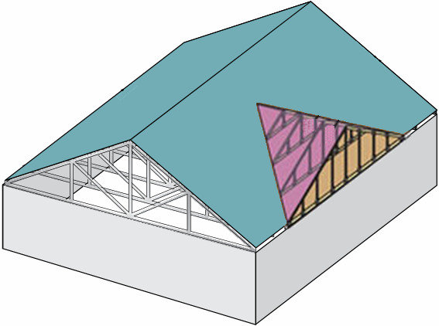
Valley Set Frame Installation
A valley set is a group of truss frames designed to sit on top of other trusses to change the direction of the roof planes
The top chord of the supporting trusses beneath valley set frames must be laterally restrained and diagonally braced. If structural sheathing is not installed, the top chords of the supporting trusses must be braced by the valley set frames, or with rows of lateral restraint and diagonal bracing.

Slide 91
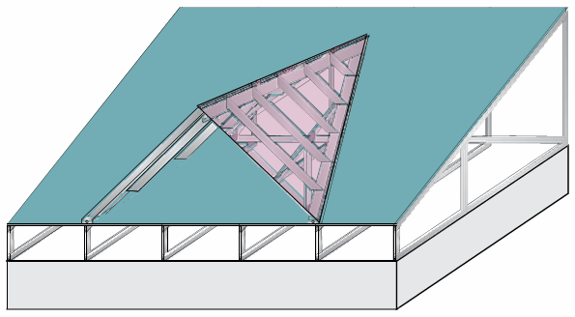
Valley Set Frame Installation
When no structural sheathing is attached to the top chords of supporting trusses beneath a valley set, the o.c. spacing of the valley set frames (as measured along the slope of the top chord of the supporting trusses) must be less than or equal to the maximum purlin spacing specified on the TDD for the top chord of the supporting trusses − unless additional restraint and bracing is provided. Add diagonal bracing to the top chord plane of the supporting trusses if the valley set frames are ≥ 20' in length.

Slide 92
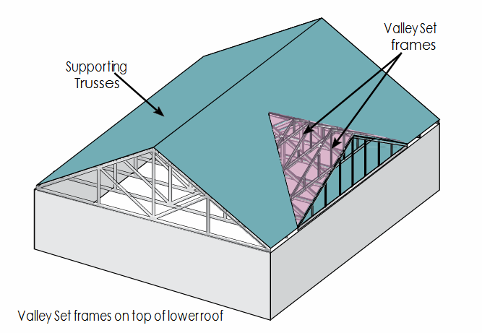
Valley Set Frame Installation
NOTE: The method used to frame a valley will affect how loads from the upper roof are distributed to the supporting trusses and, therefore, how these trusses are to be designed

Slide 93
Valley Set Frame Installation
Valley set frames (VSF) spaced at 24" o.c. or less distribute the upper roof load uniformly to the lower roof
VSF spaced at more than 24" o.c. distribute the upper roof load to the lower roof as a series of concentrated line loads applied to the lower roof at the location of each valley set frame
Conventional framing distributes the upper roof load to the lower roof as a concentrated line load acting along the valley created at the intersection of the two roofs

Slide 94
Installing Parallel Chord Trusses

Slide 95
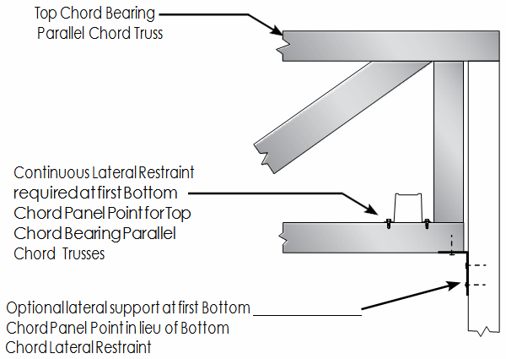
Parallel Chord Trusses
For top chord bearing parallel chord trusses, apply continuous lateral restraint at the first bottom chord panel point to prevent torsional over turning under load

Slide 96
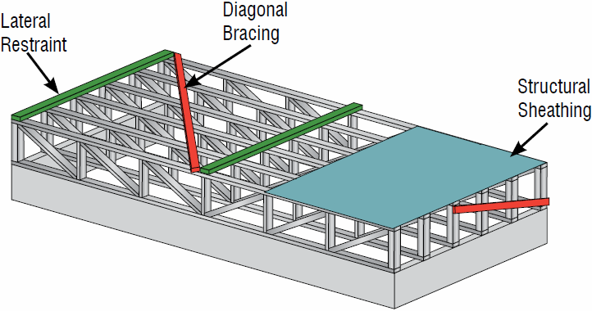
Parallel Chord Trusses
For bottom chord bearing parallel chord trusses that are properly anchored to the supports, the bottom chord lateral restraint is not required at the first bottom chord panel point

Slide 97
Installing Long Span Trusses

Slide 98
Long Span Truss Installation
Long span trusses (60' or greater) pose a significant risk to installers. The dimensions and weight of long span trusses can create instability, buckling, and collapse of the truss if it is not handled, installed, restrained and braced properly. Long span trusses can be installed safely and efficiently, but they require more detailed safety and handling measures than shorter span trusses.

Slide 99
Long Span Truss Installation
BEFORE STARTING
Hire a registered design professional to provide a temporary restraint/bracing plan and to supervise the erection process
Develop a safe, effective truss installation method and inform all crew members of their roles
Use installers who have experience installing trusses greater than 60' in span
Inspect the trusses

Slide 100
Long Span Truss Installation
BEFORE STARTING
Document all truss damage including red rust. Prior to installation, repair all trusses according to the repair details prepared by the truss designer or a registered design professional.
Ensure that the walls and supporting structure are stable and adequately restrained and braced
Have all necessary lifting equipment and building materials on hand
Make sure the crane operator understands the special hoisting requirements of long span trusses

Slide 101
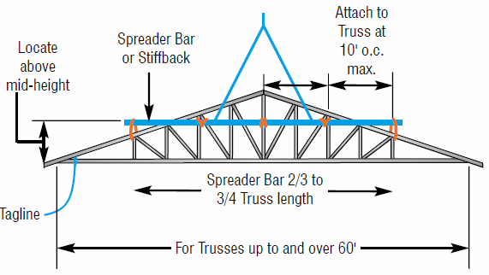
Long Span Truss Installation
Use a spreader bar to keep trusses straight during hoisting

Slide 102
Long Span Truss Installation
Build the first five trusses into a stable base unit with all structural sheathing, restraint and bracing
Add a temporary center support. It is recommended that temporary supports be set up at interior locations during erection/installation to provide greater stability and increased safety. Temporary interior supports should be left in place until all PBSB is installed.

Slide 103
Installing Other Specialty Trusses

Slide 104
Other Special Trusses
Field-spliced trusses
Buildings with open ends (no end walls)
Multi-ply trusses
Special application trusses
NOTICE: Girder truss plies are to be completely and securely attached together prior to attaching the supported trusses to the girder truss
Attach lateral restraint and diagonal bracing to each ply of multi-ply trusses

Slide 105
Trusses for Special Applications
Trusses installed for ornamental purposes or other special applications that are not intended to carry roof, floor, or exterior environmental loads (snow, wind, etc.) still require bracing to prevent lateral buckling due to self weight, incidental material loads (from lattice work or other finished framing) and installation forces. The contractor is advised to adhere to the lateral restraint requirements specified on the TDD, and install diagonal bracing or structural sheathing to brace these areas.

Slide 106
Construction Loading

Slide 107
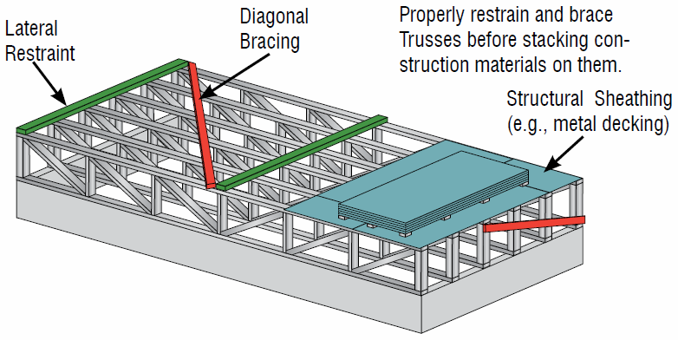
Construction Loading
Construction loads must only be placed on fully restrained and braced structures
Trusses over-stressed by excessive construction loading usually show excessive sagging (deflection) and at least a portion of this deflection will remain even after the load has been removed

Slide 108
Construction Loading “Do’s”
DO limit stacks to a reasonable amount of material that will not overload the trusses
DO stack materials along exterior supports or directly over interior supports of properly restrained and braced structures
DO restrain loads to keep from sliding
DO distribute loads over as many trusses as possible; position stacks of materials flat with the longest dimension perpendicular to trusses

Slide 109
Construction Loading “Don’ts”
DO NOT stack materials on unbraced trusses
DO NOT exceed stack heights listed in table
DO NOT allow stacks to lean against walls
DO NOT over-stack materials between supports
DO NOT drop loads of any materials on trusses
DO NOT stack materials in concentrated areas so that they overload a small group of trusses

Slide 110
Construction Loading “Don’ts”
DO NOT support mechanical units from trusses that have not been designed to support these loads
DO NOT stack materials at locations that will produce instability, such as on cantilevers or near truss-to-girder truss connections
DO NOT pile cut-off tile and/or other construction waste on truss roofs

Slide 111
Damaged Trusses

Slide 112
Repairing or Modifying Trusses
“Truss members shall not be cut, notched, drilled, spliced, or otherwise altered in any way without written concur-rence and acceptance of a registered design professional. Alterations resulting in the addition of loads to any member (e.g. HVAC equipment, piping, additional roofing or insulation, etc.) shall not be permitted without verification by the truss design engineer or truss designer that the truss is capable of supporting such additional loading.”
− AISI Code of Standard Practice for CFS Structural Framing

Slide 113
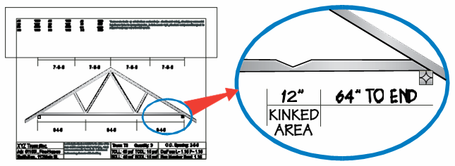
Dealing with a Damaged Truss
If a truss is damaged, altered or improperly installed:
Temporarily brace or support the truss to prevent further damage
Draw a picture of the damage directly on the original Truss Design Drawing, or take a digital photograph
Report damage, alterations, or installation errors to ISF immediately

Slide 114
Dealing with a Damaged Truss
Supply ISF with the following information:
Job name and number
Truss ID
Location of the truss on Truss Placement Diagram
Is the truss installed or is it still in the stack/bundle?
Provide the following information regarding damage:
Exact location of damage in relation to a known location (e.g. panel point or bearing)
Type of damage (e.g. kink, break, hole, cut, etc.)
Dimensions of the damaged area

Slide 115
Dealing with a Damaged Truss
Do not attempt to repair a truss without a repair detail from ISF
Prior to beginning repairs, lay the truss flat on a solid, level surface. If the truss is already installed, shore it up to relieve any load.
Repair the truss by following the repair detail exactly. Make sure to use the materials as specified. Seek professional guidance if anything is unclear.
If the designed repair cannot be accomplished, contact ISF for further instructions

Slide 116
Common Repairs
Some of the more common repairs specified by truss designers include:
Removing and replacing a damaged member
Attaching a CFS member over damaged chords, webs, or joints
Applying a steel gusset to reinforce the damaged area

Slide 117
Fall Protection

Slide 118
Fall Protection
OSHA standards for the regulation of fall protection in the erection of steel building materials:
29 CFR 1926.760 (commercial construction)
29 CFR 1926.502 (residential construction)
Fall protection programs and safety measures are job site and building specific
The appropriate fall protection method for each job must be determined by a person who is qualified to design, install, and use fall protection systems and is authorized to have any problems corrected

Slide 119
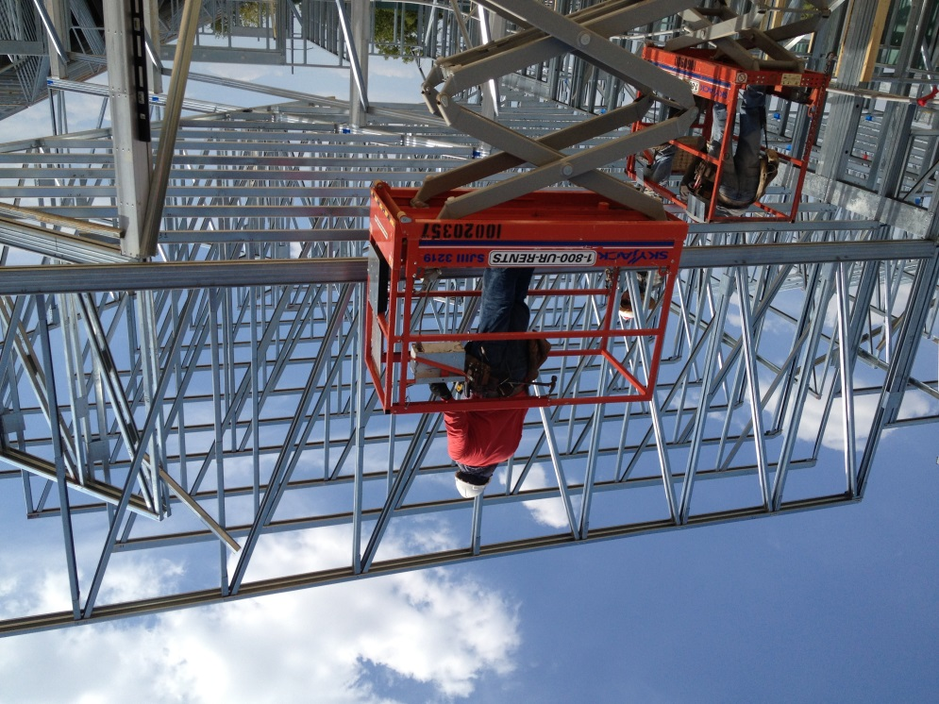
Fall Protection
While working at heights of up to 15 feet above a lower level, installers should be protected from fall hazards by guardrail systems, safety net systems, personal fall arrest systems, positioning device systems, and/or fall restraint systems
All employees working at heights over 15 feet and up to 30 feet must receive fall hazard training as required by OSHA

Slide 120
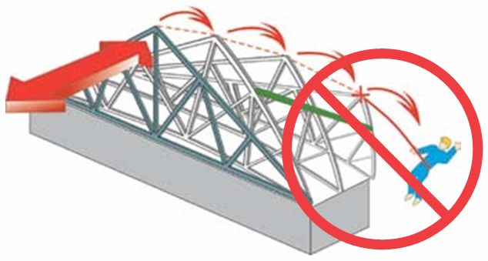
Fall Protection
Trusses alone are not designed to support fall protection anchors. Attach personal fall arrest systems to structural members capable of supporting the loads.
DO NOT use a single truss as an anchor point for any type of personal fall arrest system. A falling worker attached to a single truss could cause all trusses to collapse in a domino effect

